Slide 1

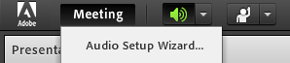

Welcome to
Teaching + Learning Tuesdays
April 16, 2019
2:30 PM
Please adjust your audio using the Audio Setup option under the Meeting menu.

Slide 4
Community
Mental Health

Slide 5



Stephanie McGuire

Slide 6
Learning Objectives
Webinar participants will learn:
Prevalence
The impact of mental illness
Common mental health issues & crises
What is Mental Health First Aid
The Mental Health First Aid action plan
Self Care
Community resources to help students and loved ones get the help they need

Slide 7
Poll question #1:
How many people in South Carolina live with Mental Health issues?

Slide 8
170,000 adults and 48,000 children live with mental health issues in SC.
Notes:
Mental illness is more prevalent than the general media and the public think. The more awareness we bring to the mental health conversation, the more apt people may become toward getting help. The average time a person waits before seeking treatment is 10 years. As with any illness the longer treatment is delayed, the more serious symptoms can become.

Slide 9
Poll question #2:
With mental health issues being common, why do you think people aren’t seeking treatment?

Slide 10

Let’s Talk About Stigma

Slide 11
Stigma
Leads to low self-esteem, isolation, and hopelessness
Deters the public from seeking and wanting to pay for care
Causes people with mental health problems to internalize public attitudes and become so embarrassed or ashamed that they often conceal symptoms and fail to seek treatment
Leads others to avoid living, socializing, or working with, renting to, or employing people with mental disorders - especially severe disorders, such as schizophrenia.
- New Freedom Commission, 2003

Slide 12
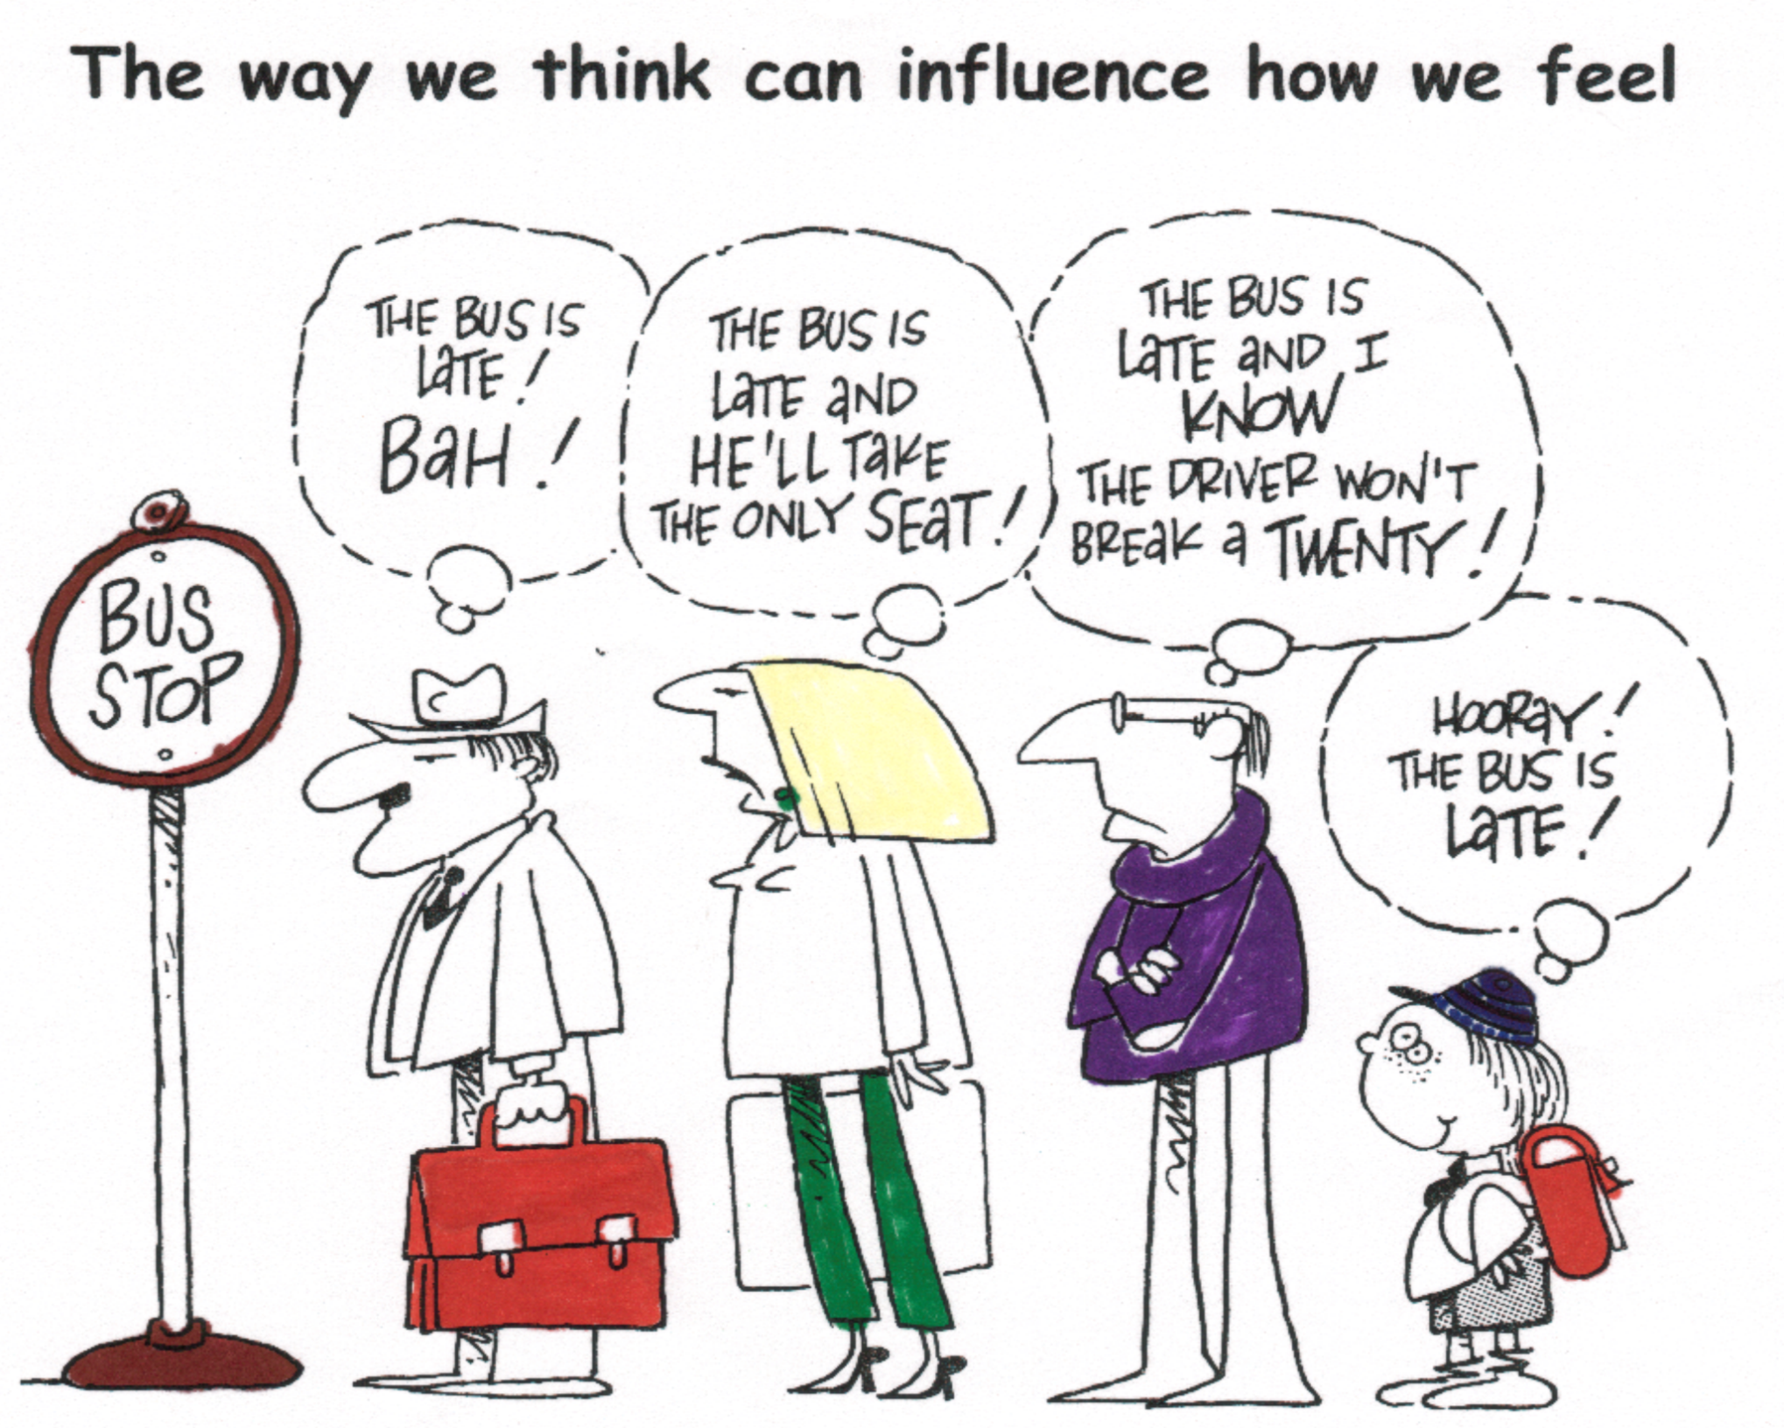

Slide 13
Poll question #3:
Rank these illnesses in order based on level of severity.
Moderate Depression
Low Back Pain
Post Tramautic Stress Disorder
Chronic Emphysema

Slide 14
The Impact of Mental Illness
Mental illnesses can be more disabling than many chronic physical illnesses. For example:
  The disability from moderate depression is similar to the impact from relapsing multiple sclerosis, severe asthma, or chronic hepatitis B.
“Disability” refers to the amount of disruption a health problem causes to a person’s ability to:
  Work
  Carry out daily activities
  Engage in satisfying relationships

Slide 15

Mental Health in the Workplace
1 in 5 American adults experiences a mental illness each year
Employers face an estimated $80 to $100 billion in indirect costs annually due to mental illness and substance use – including lost productivity and absenteeism
10.8 million full-time workers have a substance use disorder

Slide 16
Common Mental Health Issues In Students
Anxiety
Depression
Suicide and Non-Suicidal Self-Injury
Trauma
Psychosis
Substance Use Disorder
Recognize
the Signs,
Symptoms, &
Risk Factors

Slide 17

Mental Health Crises
Panic Attacks
Thoughts of Suicide or Harm
Psychosis
Substance Use
Other Crises
Notes:
Describe signs and symptoms for each
Other Crises can include: homelessness, domestic violence, resource access/needs

Slide 18

Cues: Panic Attacks
Rapid heart rate / pounding heart
Sweating / trembling
Shortness of breath, sensations of choking
Chest pain or discomfort
Nausea
Dizziness / light-headedness
Numbness or Tingling

Slide 19

Cues: Thoughts of Suicide or Harm
Talking about death or dying
Threatening to hurt or kill oneself
Discussing giving away their prized possessions
Feeling hopeless / worthless or a lack of purpose
Reckless activity
Withdrawing socially
Demonstrating rage / seeking revenge

Slide 20

Cues: Psychosis
Difficulty concentrating or paying attention
Sense of alteration of self, others, or the outside world
Odd ideas / thought patterns
Unusual perceptual experiences
Delusions
Hallucinations

Slide 21

Cues: Substance Use
Intoxication (slurred speech, etc.)
Talking about having taken drugs / used alcohol
Preoccupation with substance
Withdrawal from substance

Slide 22

Cues: Other Crises
Homelessness
-at risk/dropping out of school
-family problems/eviction
-doubling up
Domestic Violence
-Student indicates intimate partner violence and/or abuse
Resource Access/Need
-Student indicates need for: healthcare, food, utility assistance,etc.

Slide 23
https://www.youtube.com/watch?v=_oupH28FME8
Notes:
Discussion: What is YOUR role in this situation? What are some helpful/unhelpful ways to address the situation? Develop a list of helpful tactics to approaching a student in crisis: a. what tone do you use? B. what questions do you ask? Presenters provide a list of referrals for mental health / 211 resources.
Helpful VS Unhelpful tones/responses?
What questions do you ask?

Slide 24

Mental Health First Aid
Action Plan
Assess for risk of suicide or harm
Listen nonjudgmentally
Give reassurance and information
Encourage appropriate professional help
Encourage self-help and other support strategies

Slide 25
Mental Health First Aid is the initial help offered to a person developing a mental health or substance use problem, or experiencing a mental health crisis. The first aid is given until appropriate treatment and support are received or until the crisis resolves.
Notes:
The training helps employees from all levels to identify, understand, and respond to signs of addictions and mental illnesses

Slide 26


Mental Health First Aid…
  …Increases knowledge and understanding
  …Encourages people helping people
  …Supports people getting help
  …Decreases social distance
  …Increases mental wellness

Slide 27
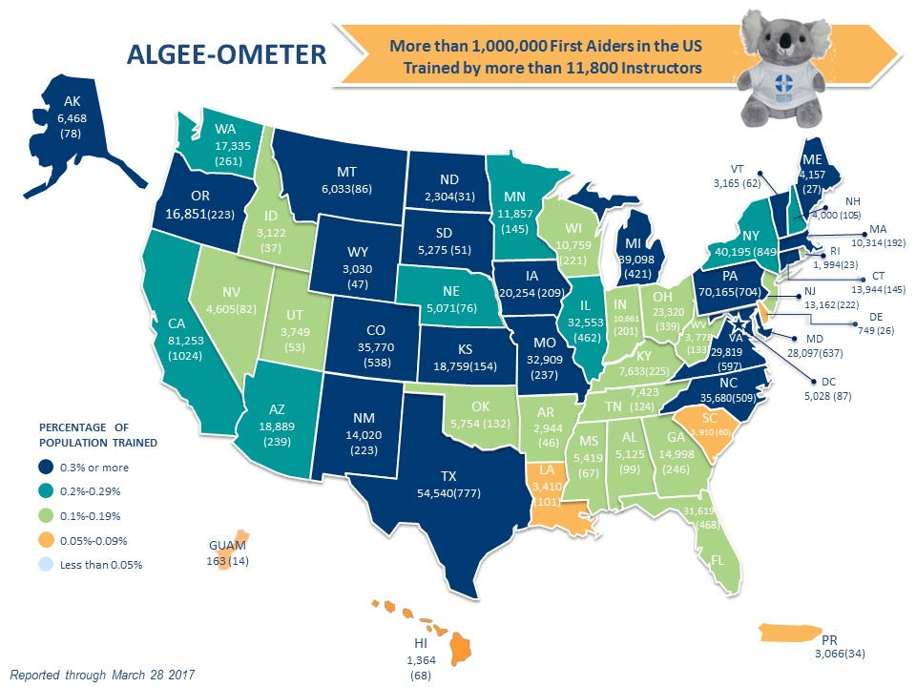
Notes:
South Carolina ranks as having less than 1% of its population trained in Mental Health First Aid. However it is 45th in the nation in overall mental health rankings. This ranking indicates a higher prevalence of mental illness and lower rates of access to care. (according to Mental Health America - The State of Mental Health in America, Ranking the states.)

Slide 28

Mental Health First Aiders Are…
Teachers, supervisors, first responders, caretakers, co-workers, journalists, parents, friends and siblings. They’re even First Ladies…
Notes:
Mental Health First Aiders are teachers, first responders and veterans. They’re neighbors, parents, coworkers and friends. They’re people in recovery, and those supporting a family member. They’re First Ladies and Mayors. Mental Health First Aiders are anyone who wants to make their community healthier, happier and safer for all.

Slide 29
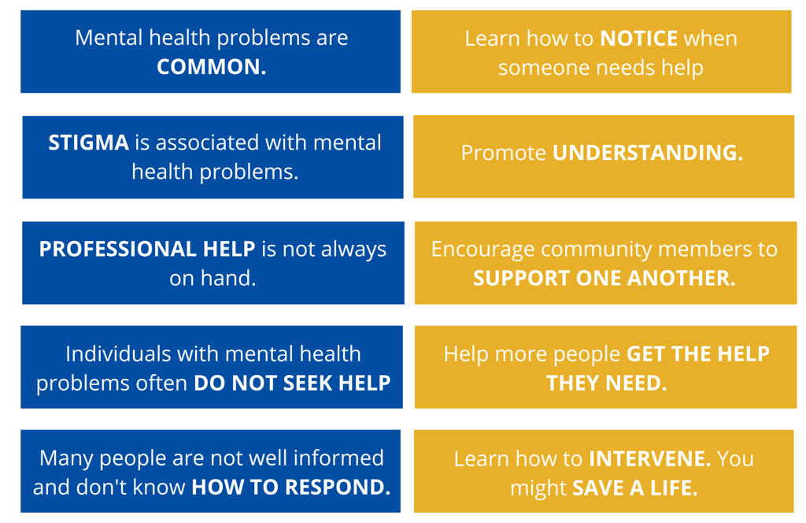
Why Mental Health First Aid?

Slide 30
Prevention
Early Intervention
Treatment
Well
Becoming Unwell
Unwell
Recovering
Where Mental Health First Aid can help on the spectrum of mental health interventions.
Notes:
The model for Mental Health First Aid can be introduced once a person is becoming unwell. It is the initial help to a person experience a mental health concern.

Slide 31
What is Self-Care?
The ability to function effectively in the world while meeting the multiple challenges of daily life with a sense of energy, vitality and confidence.
(Adapted from CHS-Syracuse University)
“A state of effective coping that emphasizes the importance of achieving and maintaining a healthy personal rhythm”.

Slide 32

This Photo by Unknown Author is licensed under CC BY
Notes:
Self Care Activity : What are some ways students or we as professionals can take advantage of self care?

Slide 33
Self-Care Includes any intentional actions you take to care for your physical, mental, spiritual, emotional, and financial health.
Highly individualized
Requires our active engagement
Requires commitment – non-negotiable
Is proactive and occasionally reactive!

Slide 34
What resources for mental health do you currently have in your community?

Slide 35
South Carolina Mental Health
Resources
Department of Mental Health
  17 Community Mental Health Centers
SC Youth Suicide Prevention Initiative (SCYSPI)
SC 2-1-1
National Alliance on Mental Illness (NAMI)
National Suicide Prevention Lifeline 800.273.TALK(8255)
SC Thrive Contact Center 800.726.8774
  For a verified list of local Mental Health providers accepting Medicaid
  A list of other community resources, including telephone application assistance for Medicaid, SNAP, and Senior Resources

Slide 36
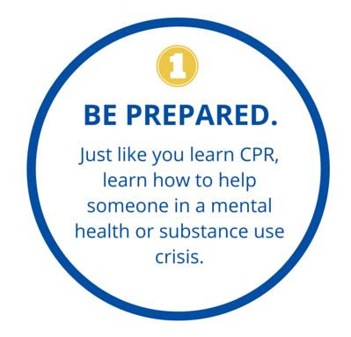

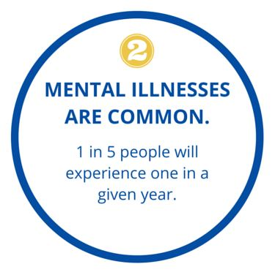
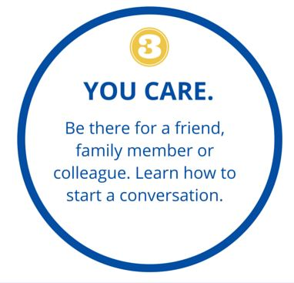
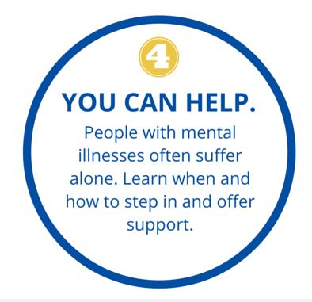
Notes:
Why is Mental Health First Aid necessary? Mental crises can happen anywhere. So you need to be prepared. (2) Also, mental illnesses are common. We want to break down the stigma attached to mental illness so people can seek the help they need. (3) Many people often do not know what to say when facing someone with a mental crisis. As a concerned friend or co-worker, learn how to have the conversation and (4) learn how to step in and offer support.

Slide 37

What Happens Next?
Visit scthrive.org/trainings to register for an upcoming Mental Health Training or Schedule one on your campus
Photo by Ev on Unsplash

Slide 39


Upcoming TLT Sessions
May 22, 2019 – We plan to live-stream the Keynote Presentations from the Spring 2019 Retention Institute
  Likely at 10:30am and 1:00pm
  Additional information will be forthcoming
June 18, 2019 - Institutional Research and Assessment
Want to showcase your expertise? Is there a teaching technique that has been effective in the classroom? Apply to be a TLT presenter!
For more information and full schedule: www.sctechsystem.edu/tlt

Slide 40
Give us your feedback
https://www.surveymonkey.com/r/april19tlt

